Slide 1


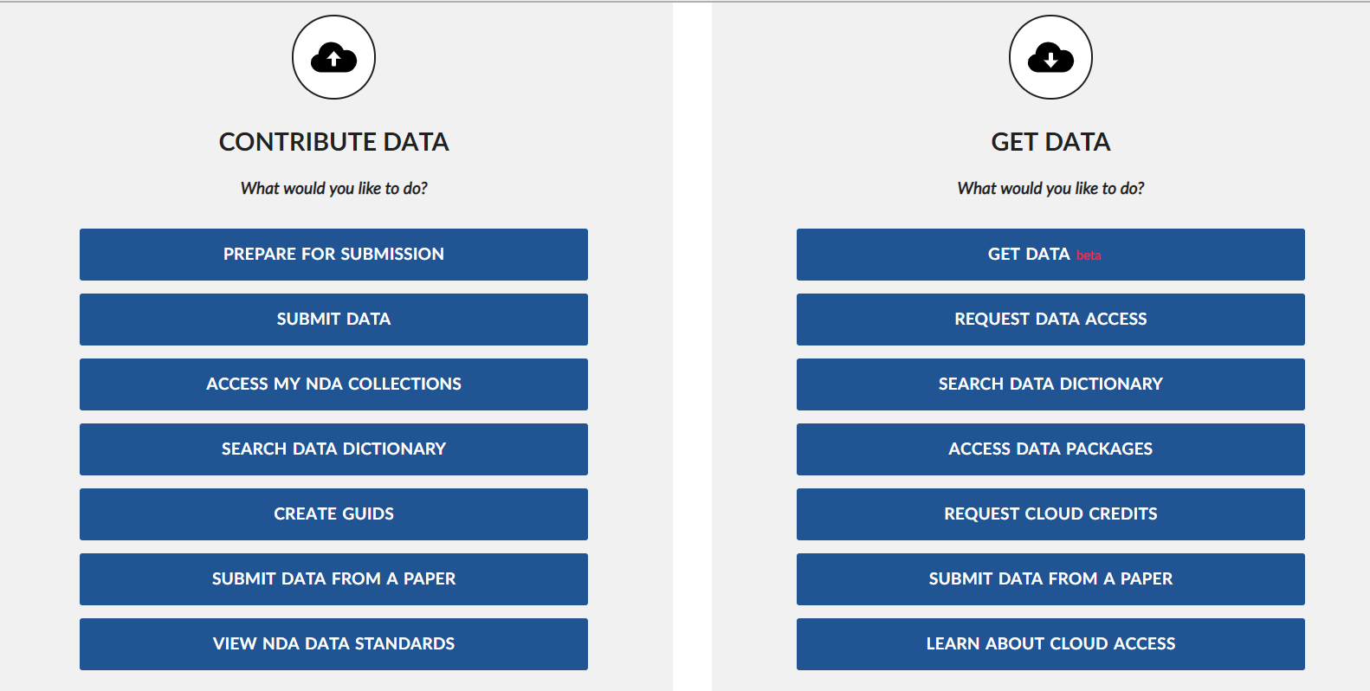
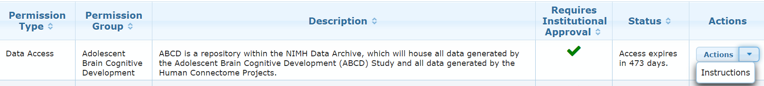
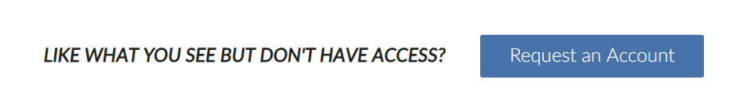
Accessing ABCD Data on the NIMH Data Archive
Request NDA Account
Receive notice to complete DUC
(~ 24 hours)
Submit signed DUC to NDA
Receive notice that DUC is approved
(~ 1-2 weeks)
5. Access data
DUC
Notes:
To include in DEAP demo presentations
How to access ABCD data
Sign up for an NDA account
Wait approximately 24 hours and receive notification to complete DUC
Access data

Slide 2

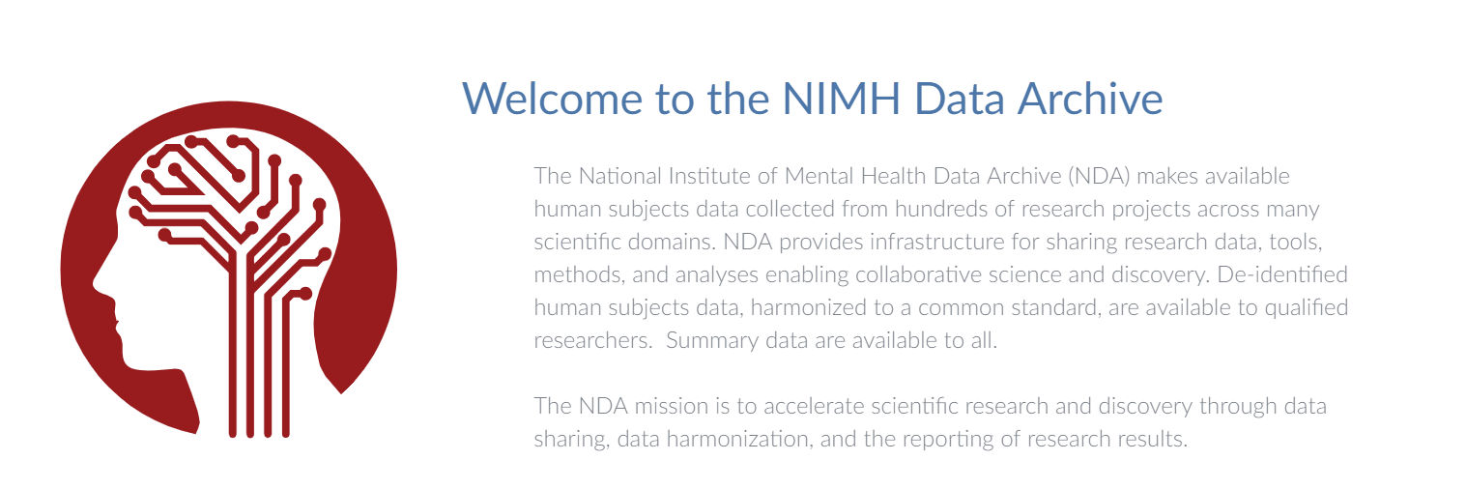
Responsible Data Use
You and your institution have agreed to adhere to the following ABCD data use terms & conditions:
Use data for research only
Do not reidentify subjects
Keep the data secure
Work only with approved users & do not distribute the data
Delete the data after use
Submit your results to an NDA study
There are penalties for violating these terms of use
The agreement is valid for one year

